Slide 1
MACHINE LEARNING II · CAPSTONE
Emissions from Above
Classifying Power Plant Pollution from Satellite Imagery and Emissions Data
Rob Scott · Ananya Sen · Mateo Ronquillo · Efrain Rodriguez
The University of Chicago Booth School of Business
Notes:
This is a project on whether machine learning, applied to satellite imagery, can independently verify what power plants self-report about their emissions. We'll walk through the problem, the data, our four-task ML pipeline, the results so far, and what this means for regulators, ESG investors, and climate auditors.

Slide 2
01 · THE PROBLEM
Emissions data is self-reported, delayed, and uneven
Power plants are among the largest point-source emitters globally yet monitoring relies on voluntary, self-reported data that may be late or inaccurate.
Satellite imagery offers an independent, continuous, scalable observation channel that does not depend on what an operator chooses to disclose.
REGULATORS
Prioritize field audits with imagery-flagged candidates
ESG INVESTORS
Verify corporate emissions disclosures against satellite signal
STAKEHOLDER QUESTIONS
Can a plant's pollution tier be inferred from its visible + IR signature?
Which visual features (plume, thermal, footprint) drive intensity?
Can we flag plants whose appearance suggests under-reporting?
Does accuracy vary by fuel type or geography?
CLIMATE AUDITORS
Extend oversight into weak-reporting jurisdictions globally
Emissions from Above · Scott · Sen · Ronquillo · Rodriguez
2 / 12
Notes:
The core problem: emissions monitoring today depends on what plants choose to report, when they choose to report it. That's slow, uneven, and easy to game. We have three primary audiences including regulators who want to know where to send inspectors, ESG investors who want to verify corporate disclosures, and climate auditors who need to extend oversight into places without strong reporting regimes.

Slide 3
02 · DATA
4,454 plants: imagery joined to emissions
SATELLITE IMAGERY · USPPDS
EPA eGRID 2014
NAIP: 1 m/px (~1,115×1,115), annotation ground truth
Landsat 8: 15 m/px (~75×75), primary ML input
Resized bilinearly to 64×64 for CNN compatibility; per-channel min-max normalization; augmentation with random flips, ±15° rotation, ±20% brightness.
Annual CO₂ emissions and intensity (lbs/MWh)
Nameplate capacity, capacity factor, heat rate
Net generation and primary fuel category
Median imputation, StandardScaler on train split
CLASS IMBALANCE
GAS outnumbers NUCLEAR 25:1
Addressed via WeightedRandomSampler + class-weighted CE loss
Rare classes still drive macro-F1, ensuring model selection isn't dominated by the majority class.
Emissions from Above · Scott · Sen · Ronquillo · Rodriguez
3 / 12
Notes:
Two data sources joined on plant ID: satellite imagery from USPPDS (we work primarily with 15-meter Landsat patches resized to 64x64 for the CNNs) and EPA's eGRID 2014 emissions records for the labels and tabular covariates. The biggest data challenge is class imbalance which we handle with weighted sampling and class-weighted loss. Note these are approximate sample counts shown for illustration; the exact NUCLEAR count is 46 per the report.

Slide 4
03 · METHODOLOGY
A four-task pipeline, labels to anomalies
TASK 1
TASK 2
Binary Classification
Fuel-type Detection
High vs. low pollution
8-class multi-class
ResNet-18 fine-tuned from ImageNet, dropout (p=0.3), AdamW + cosine LR over 30 epochs. WeightedRandomSampler with class-weighted CE. Grad-CAM validates spatial attention.
EfficientNet-B0 fine-tuned, macro-F1 model selection prevents the dominant GAS class from masking poor minority performance. t-SNE / PCA assess latent separability.
TASK 3
TASK 4
Emissions Regression
Anomaly Detection
Continuous CO₂ intensity
Flag under-reporting
Three-way comparison: GBT tabular baseline, CNN image-only, late-fusion multimodal. Huber loss reduces outlier sensitivity on the heavy-tailed emissions distribution.
Weighted ensemble: residual Z-score (40%), Isolation Forest on CNN embeddings (25%), One-Class SVM tabular (20%), MC Dropout uncertainty (15%).
Emissions from Above · Scott · Sen · Ronquillo · Rodriguez
4 / 12
Notes:
Four tasks of escalating difficulty. Task 1: can we tell high from low pollution from imagery? Task 2: can we identify fuel type, which is itself a strong emissions proxy? Task 3: predict continuous emissions intensity, testing whether imagery adds signal beyond what tabular data already provides. Task 4: the payoff: train on verified plants, then flag plants whose imagery looks much dirtier than what they report.

Slide 5
04 · TASK 1 RESULTS
Imagery alone classifies pollution well
0.866
76.4%
19.5%
AUC-ROC on held-out test
Recall on high-pollution plants
False-positive rate (Low → High)
CONFUSION MATRIX · n = 443
INTERPRETATION
Predicted Low
Predicted High
AUC of 0.866 is well above the 0.5 random baseline (strong discriminative power from 64×64 px patches alone).
76% recall on high-emitters at a low false-positive rate makes this operationally viable for regulatory triage.
False positives concentrate near the quartile boundary (Grad-CAM analysis confirms attention is on plant infrastructure, not confounding background texture).
244
59
True Low
TN
FP
33
107
True High
FN
TP
Emissions from Above · Scott · Sen · Ronquillo · Rodriguez
5 / 12
Notes:
Task 1 is the headline result. From 64-pixel Landsat patches alone, the ResNet-18 hits 0.866 AUC. What matters operationally: we catch about three of every four high-pollution plants while only mislabeling about one in five low-pollution plants. The 59 false positives we did get cluster right at the quartile boundary, which is exactly where you'd expect the model to be uncertain.

Slide 6
05 · TASK 2 RESULTS
Fuel detection: structure beats emissions
39.5%
overall accuracy across 8 fuel classes · 3.2× random baseline
WHAT WORKS
Structurally distinct plants: HYDRO (68%), WIND (67%), OIL (57%), COAL (51%). They have unique visual footprints even at 15m resolution.
WHAT FAILS
Fossil-fuel lookalikes: GAS (6%), NUCLEAR (14%), SOLAR (28%) share thermal-plant configurations or small footprints. t-SNE confirms these classes do not separate cleanly in embedding space.
Emissions from Above · Scott · Sen · Ronquillo · Rodriguez
6 / 12
Notes:
Task 2 splits cleanly into a 'wins' story and a 'limits' story. Hydro dams and wind farms have such unique visual footprints (turbines, water) that even 15-meter imagery picks them up. But the moment you ask the model to tell a gas plant from a coal plant from a biomass plant, accuracy collapses. They all look like thermal plants from space at this resolution. That's our most important finding: resolution is the binding constraint, not architecture.

Slide 7
06 · TASK 3 RESULTS
Tabular covariates dominate; fusion beats image alone
0.946
0.488
0.199
GBT (tabular) R² on test set
Late-fusion (image + tabular) R²
CNN image-only R²
MODEL COMPARISON · TEST SET (log scale)
INTERPRETATION
Model MAE RMSE R²
────────────────────────────────────────
GBT Tabular 0.321 0.831 0.946
Late Fusion (img+tab) 1.596 2.562 0.488
CNN Image Only 2.095 3.204 0.199
GBT on eGRID covariates is the dominant signal (R² = 0.946). Capacity, heat rate, and fuel type explain most of the variance in annual CO₂ intensity.
Late fusion (R² = 0.488) outperforms the image-only CNN (R² = 0.199), confirming that satellite patches add signal beyond tabular data — but cannot replace it.
Next step: add Landsat thermal TIRS bands to the CNN branch to close the gap, as thermal signatures directly encode heat output from fossil-fuel combustion.
Emissions from Above · Scott · Sen · Ronquillo · Rodriguez
10 / 12

Slide 8
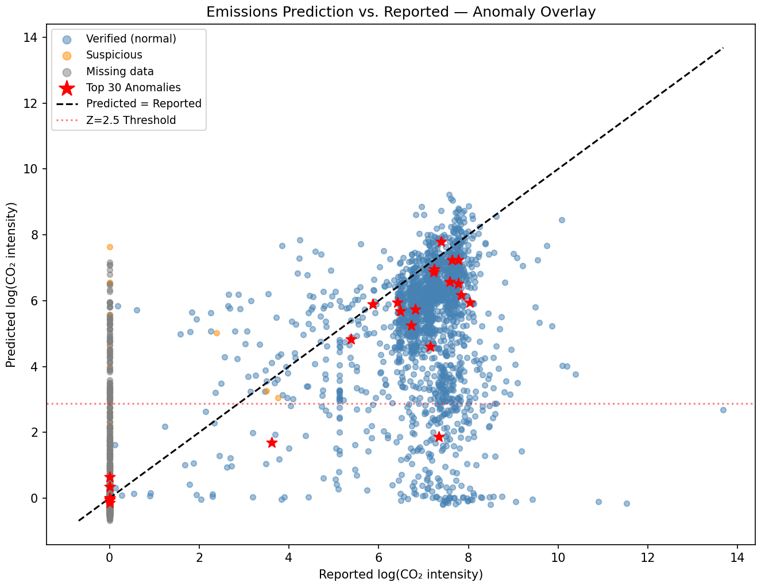
07 · TASK 4 RESULTS
71 plants flagged; model predicts higher than reported
71
320
98
4,435
Flagged by residual Z > 2.5
Suspicious fossil plants (with imagery)
Flagged by Isolation Forest
Total plants analysed
INTERPRETATION
Points above the dashed line (predicted > reported) are the primary anomaly candidates. Red stars mark the top 30 by ensemble score.
NUCLEAR and COAL show the highest median ensemble scores, consistent with their greater thermal-plant configuration variability and historical reporting inconsistencies.
CA (5) and MN (4) lead the geographic distribution of top-30 anomalies, warranting priority regulatory review in those states.
Emissions from Above · Scott · Sen · Ronquillo · Rodriguez
11 / 12

Slide 9
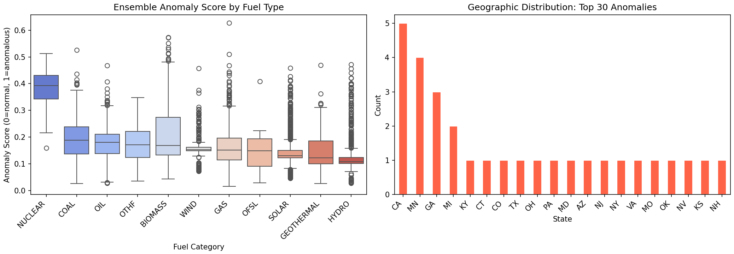
08 · TASK 4 RESULTS — ANOMALY SCORES BY FUEL TYPE & GEOGRAPHY
NUCLEAR and COAL carry the highest anomaly scores
KEY FINDINGS
NUCLEAR median score ~0.40 is the highest across all fuel classes.
CA leads with 5 flagged plants; MN follows with 4.
HYDRO scores lowest — consistent with its zero-emissions profile and clean visual signal.
ENSEMBLE WEIGHTS · Residual Z-score 40% · Isolation Forest 25% · One-Class SVM 20% · MC Dropout Uncertainty 15%
Convergent evidence from all four signals is required before a facility appears on the watchlist — no single detector can flag a plant alone. The full ranked watchlist (4,435 plants) is available in anomaly_watchlist.csv for regulatory partner review.
Emissions from Above · Scott · Sen · Ronquillo · Rodriguez
12 / 12

Slide 10
09 · LIMITATIONS
Where the model struggles and how to fix it
CURRENT CONSTRAINTS
RECOMMENDED NEXT STEPS
Resolution ceiling
01
Upgrade imagery
15m Landsat patches resized to 64×64 cannot resolve stack geometry or cooling-tower detail that distinguishes fossil-fuel types.
Add NAIP 1m/px for detail and Landsat TIRS thermal bands for heat signatures so it directly targets fossil-fuel confusion.
Spectral coverage
02
Time-align labels
RGB-only input ignores thermal infrared (TIRS) bands that directly capture heat signatures from cooling systems and stacks.
Use EPA CAMPD hourly CEMS data matched to image acquisition dates (turns the regression into a true continuous signal).
Temporal snapshot
03
Pilot anomaly watchlist
Annual eGRID 2014 labels paired with single-image patches and no time alignment with hourly CEMS data or seasonal variation.
Run Task 4 ensemble on flagged plants with a regulatory partner; measure precision of follow-up investigations.
Geographic scope
04
Generalize globally
US-only training; generalization to international plants (where independent monitoring matters most) is untested.
Extend to WRI Global Power Plant Database and test whether the model holds in jurisdictions with weaker reporting.
Emissions from Above · Scott · Sen · Ronquillo · Rodriguez
7 / 12
Notes:
Honest limitations matter as much as the wins. Our biggest constraint is resolution since we're working with patches barely large enough to see a plant's outline. Higher-resolution imagery and thermal bands are the single highest-leverage investment. Time-aligned hourly data, an anomaly-detection pilot with a regulator, and global generalization round out the roadmap.

Slide 11
10 · BUSINESS IMPACT
An independent layer over self-reported data
Three of every four high-pollution plants are correctly flagged. GBT regression achieves R² = 0.946. 71 plants flagged as potential under-reporters.
REGULATORY OVERSIGHT
ESG SCREENING
CLIMATE COMPLIANCE
Independent verification
Disclosure verification
Global coverage
Prioritize inspection budgets toward facilities whose satellite signature contradicts their disclosures. Extends EPA enforcement reach without proportional headcount growth.
Provide investors and ratings agencies an imagery-based signal independent of corporate self-reporting. Surfaces disclosure mismatches before they become reputational events.
Scales to jurisdictions where formal reporting is weak or absent. The same model, retrained on regional imagery, applies anywhere Landsat data exists.
RECOMMENDED PILOT Start with the 71 Z-score-flagged NUCLEAR and COAL plants in CA and MN. Upgrade CNN input to include Landsat TIRS thermal bands to close the regression gap (R² from 0.199 to target 0.6+). Validate watchlist precision with a regulatory partner before broader deployment.
Emissions from Above · Scott · Sen · Ronquillo · Rodriguez
8 / 12
Notes:
Why this matters beyond an academic exercise: today's emissions monitoring waits on what plants choose to disclose. Our framework gives three distinct stakeholders a continuous, independent signal so regulators get a triage tool, investors get a disclosure check, and climate auditors get reach into jurisdictions without strong reporting. The concrete next step is a 100-facility pilot with a regulatory partner.

Slide 12
CLOSING
Satellites can see what plants won't say.
0.866
39.5%
0.946
71
3 of 4
Task 1 AUC-ROC
Task 2 overall accuracy
Task 3 GBT R²
Task 4 plants flagged
High-emitters caught
Questions?
Emissions from Above · Scott · Sen · Ronquillo · Rodriguez
9 / 12
Notes:
Closing: three takeaways. The classifier works (0.866 AUC). It catches three of four high-emitters with low false positives. And the next frontier is fossil-fuel discrimination, which we unlock with thermal bands and higher resolution. Happy to take questions.

